Slide 1

A study of SOFTWARE RELIABILITY GROWTH WITH TESTING COVERAGE
BY : BASRAH YOUSUF
ROLL NO: 14
UNDER THE GUIDANCE OF DR. JAVAID IQBAL

Slide 2
INTRODUCTION
Software reliability is the likelihood of the failure free function of a software in a given period of time under certain circumstances.
Software testing is the key activity for determining and removing faults and consequently improving reliability of a software.
Testing coverage measures quantify the degree of thoroughness of testing.
Software reliability growth models (SRGM) are the mathematical functions that estimate the reliability of a software.
SRGM’s help software developers to evaluate the quality of tested software and determine how much more additional testing is needed to improve the reliability of the software.
Proposed model is based on NHPP.
NHPP models ,model the failure occurrence rate as a function of time i.e failure rate is time varying.

Slide 3
Nhpp models
NHPP model assumptions include;
software faults follow NHPP.
the debugging process takes place immediately when an error is detected.
the software fault intensity rate at anytime is proportional to the number of remaining faults.
Some existing NHPP models include;
GO model
Yamada Delayed S shaped model
Inflected S shaped model by Ohba
Yamada imperfect debugging model

Slide 4
PROPOSED MODEL
The proposed model is based on the following assumptions:
Software faults’ occurrence and removal follow NHPP.
The software failure rate at any time is a function of fault detection rate and the number of faults remaining in the software at that time.
The fault detection rate can be expressed by;
c’(t)/1-c(t)
c(t) =the percentage of the code that has been examined up to time t
c’ (t) =the derivative of the testing coverage function.
When a software failure is detected, an immediate debugging starts, and either;

Slide 5
PROPOSED MODEL
the total number of faults is reduced by one with probability p, or
the total number of faults remains the same with probability 1-p.
During the fault repair process, whether the fault is removed completely or not, new faults are introduced with a probability constant alpha.
MODEL DEVELOPMENT
Consider c(t) the percentage of the code that has been covered up to time t.
c(t) is an increasing function of testing time t and after the software turns stable it becomes flat at the tail.
Thus, the function c ‘(t)/(1-c(t)) is used to denote the fault detection rate which has been taken as the common assumption by SRGMs considering testing coverage.

Slide 6
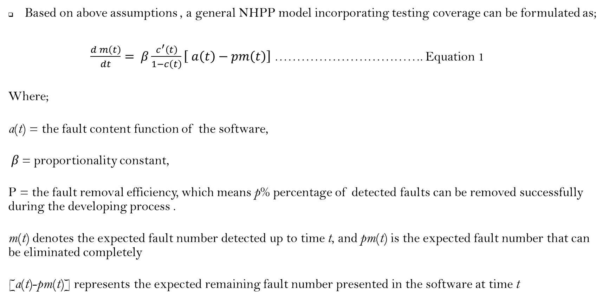
PROPOSED MODEL
Based on above assumptions , a general NHPP model incorporating testing coverage can be formulated as;
$\frac{d m\left(t\right)}{dt}= β\frac{c^{′}\left(t\right)}{1−c\left(t\right)}\left[ a\left(t\right)−pm\left(t\right)\right]$ ……………………………. Equation 1
Where;
a(t) = the fault content function of the software,
β = proportionality constant,
P = the fault removal efficiency, which means p% percentage of detected faults can be removed successfully during the developing process .
m(t) denotes the expected fault number detected up to time t, and pm(t) is the expected fault number that can be eliminated completely
[a(t)-pm(t)] represents the expected remaining fault number presented in the software at time t

Slide 7
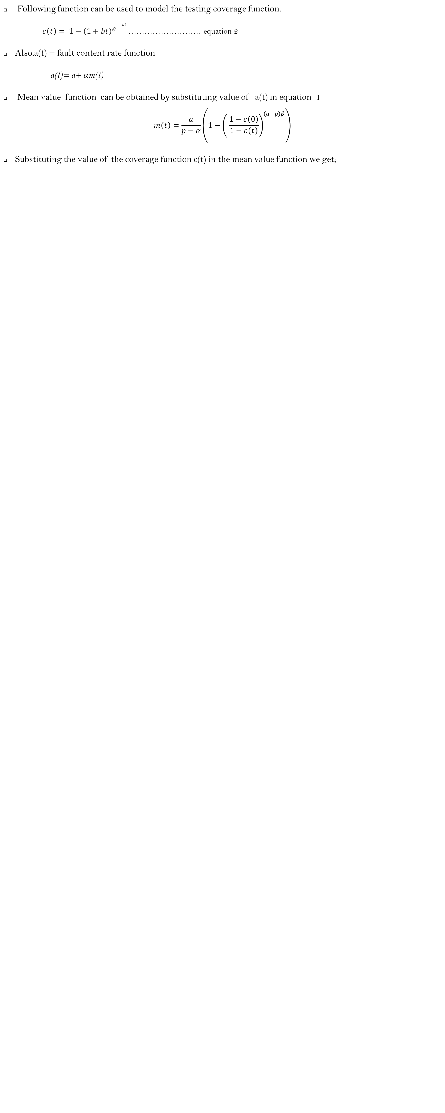
PROPOSED MODEL
Following function can be used to model the testing coverage function.
$c\left(t\right)= 1−\left(1+bt\right){e−}^{bt}\text{……………………… }\text{equation}\text{ 2}$
Also,a(t) = fault content rate function
a(t)= a+ αm(t)
Mean value function can be obtained by substituting value of a(t) in equation 1
$$m\left(t\right)=\frac{a}{p−α}\left.\left(1−{\left.\left( \frac{1−c\left(0\right)}{1−c\left(t\right)}\right.\right)}^{\left(α−p\right)β}\right.\right)$$
Substituting the value of the coverage function c(t) in the mean value function we get;

Slide 8

PROPOSED MODEL

Slide 9

PROPOSED MODEL
Therefore, the mean value function for the proposed model is;
It should be noted that error generation and fault removal efficiency as well as testing coverage are all combined into the proposed model.

Slide 10
ESTIMATION METHOD
LEVENBERG MARQUADT ALGORITHM
is an iterative algorithm for unconstrained models
Used in non linear curve fitting problems
It finds only a local minimum
Minimization starts with a initial guess parameter β.
In each iteration step the guess parameter is replaced by β +θ
If β +θ falls below predefined limits , the iteration stops and last parameter β is the optimal solution.

Slide 11
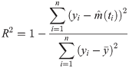
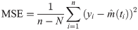
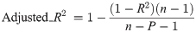
RESULTS AND COMPARISONS
Here, we examine the performance of the proposed model and compare it with other existing NHPP models.
R Squared measure : R Sq is the measure of how successful the fit is in explaining the variation of data.
MSE measure : MSE is the mean or average of the sum of the difference between actual and estimated values.
3. Adjusted R square: modified version of R squared that has been adjusted for the number of predictors.

Slide 12
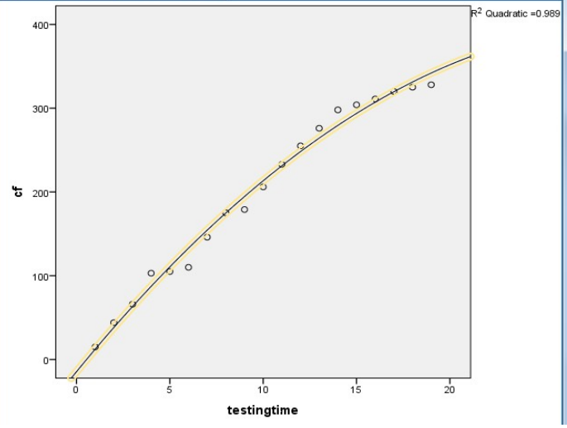
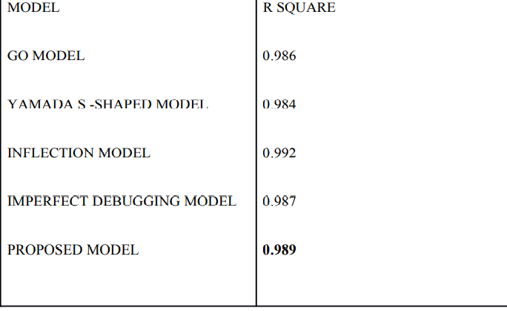
APPLICATION PROGRAM DATA (Dataset 1)
RESULTS OF DATA SET 1

Slide 13
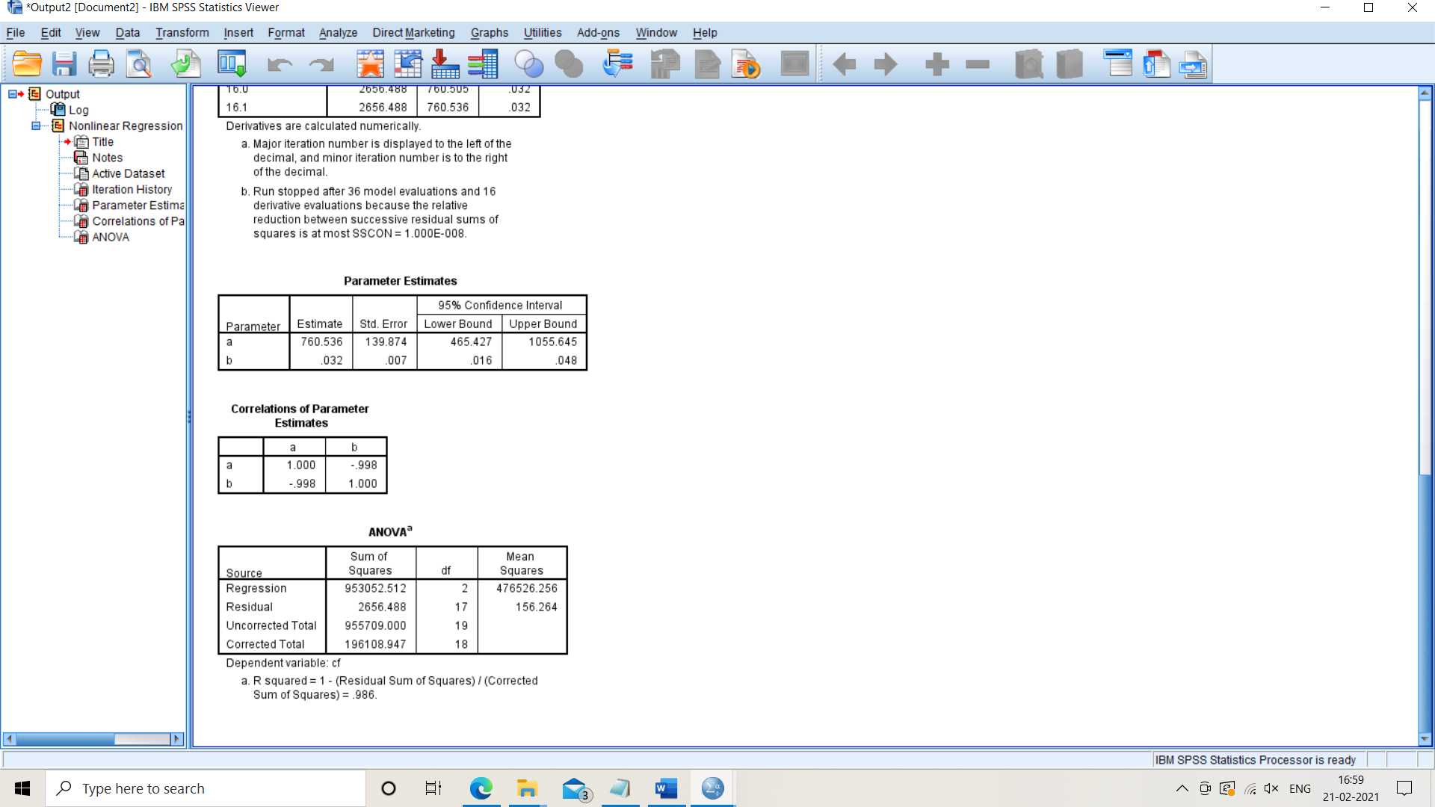
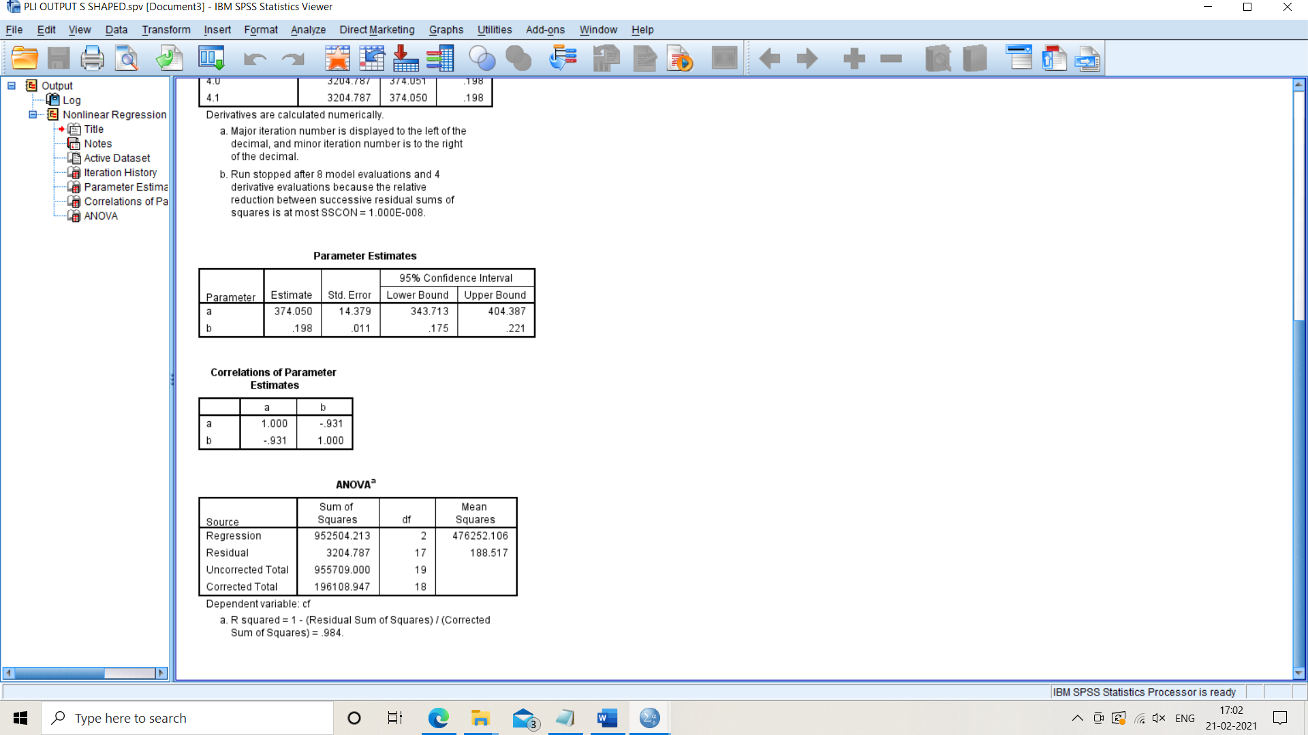
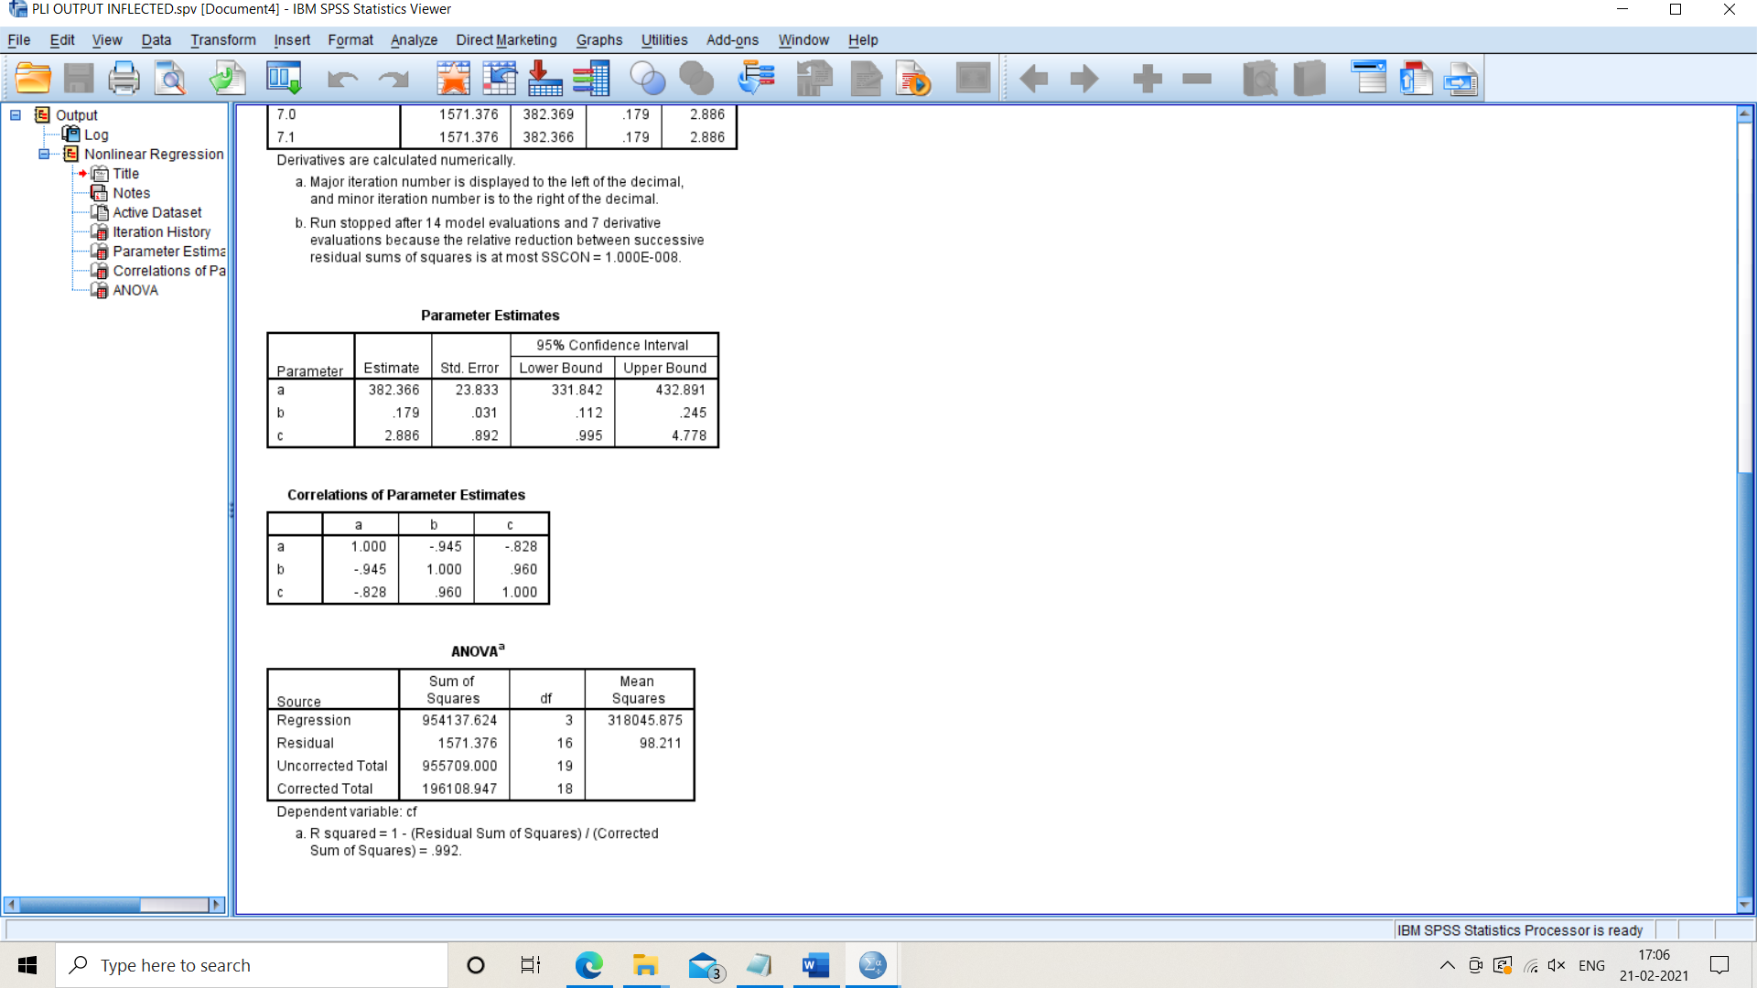
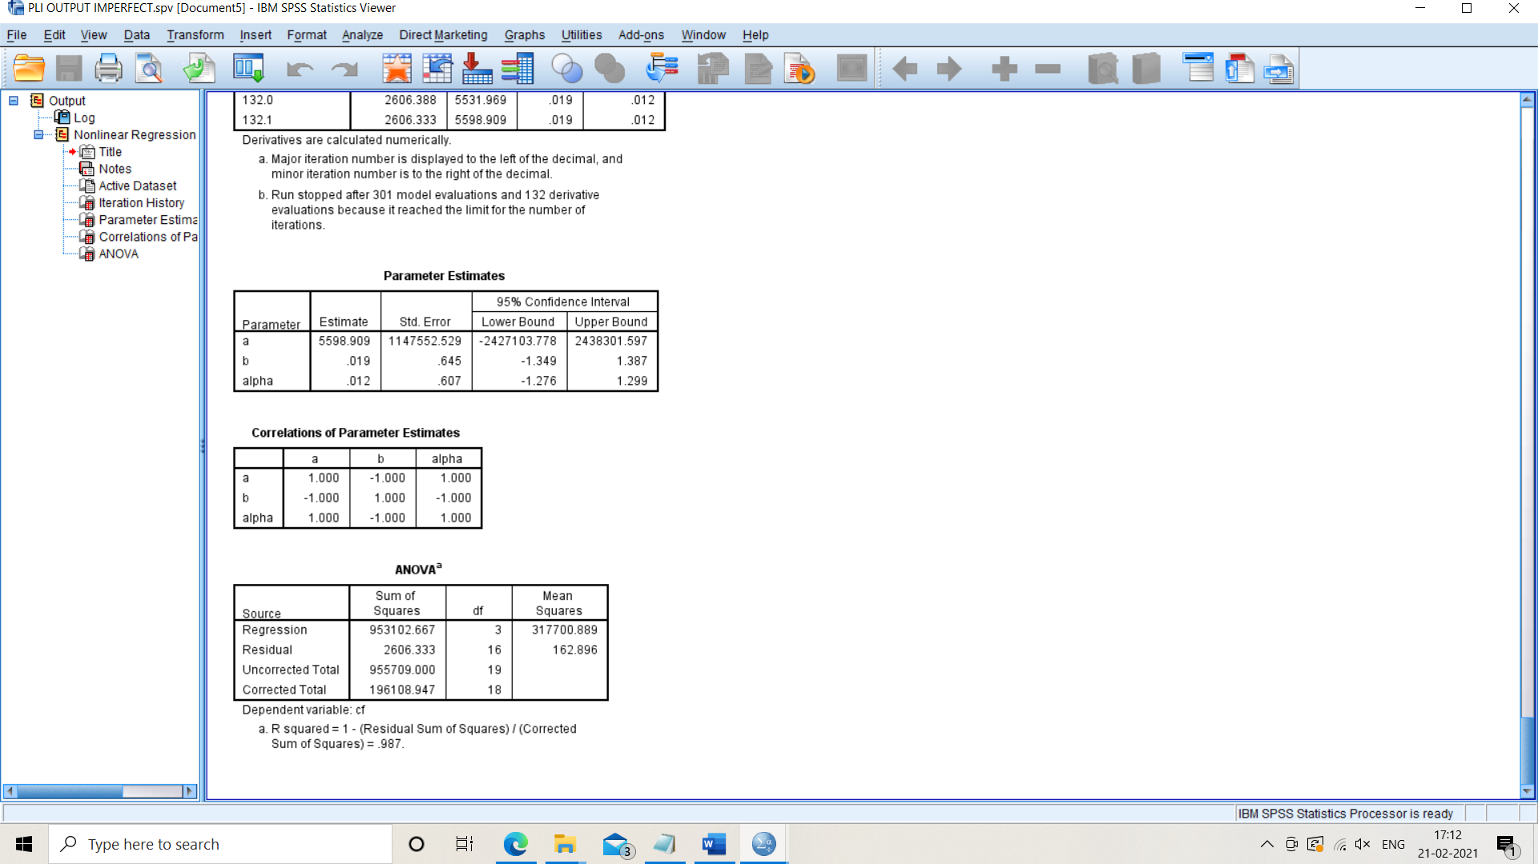

Slide 14
R squared of proposed model

Slide 15
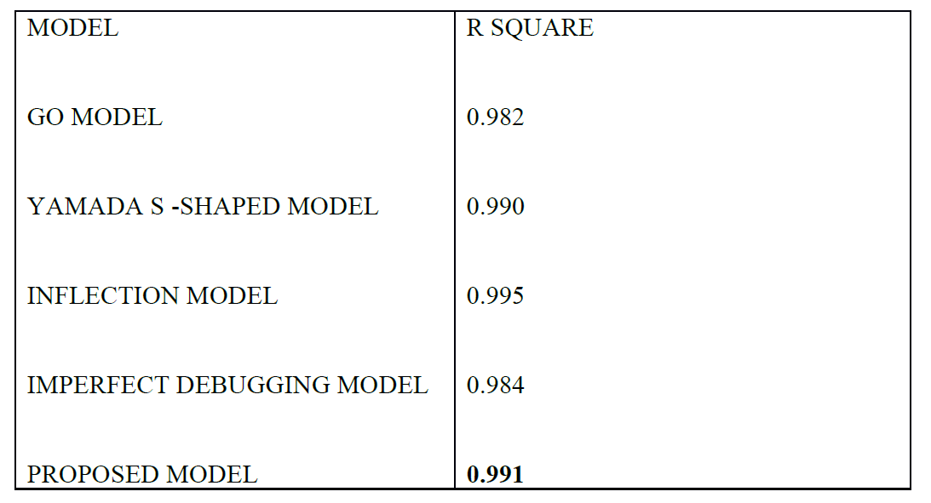
TANDEM SOFTWARE DATA (DATASET 2)
RESULTS OF DATA SET 2

Slide 16
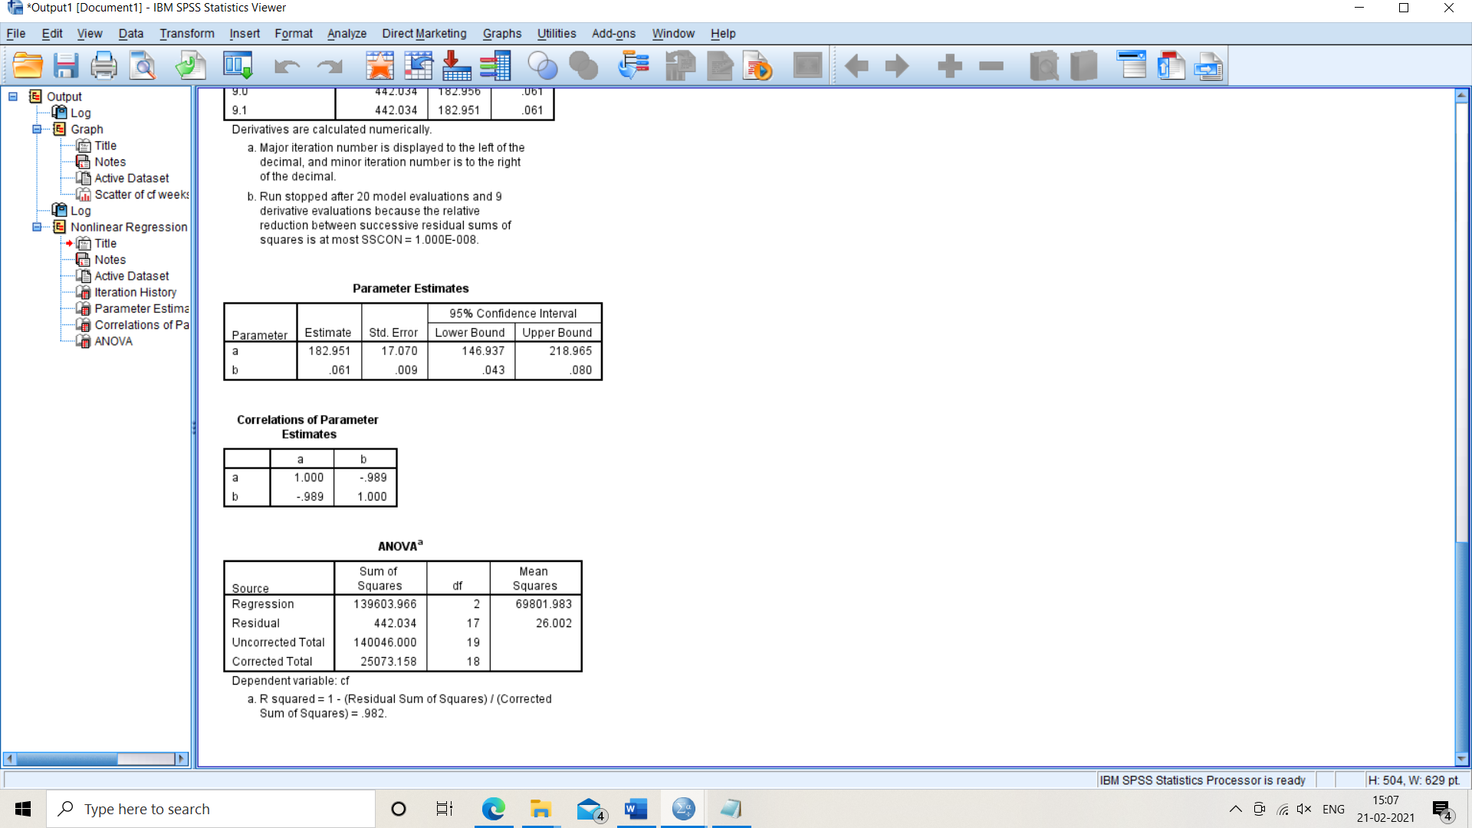

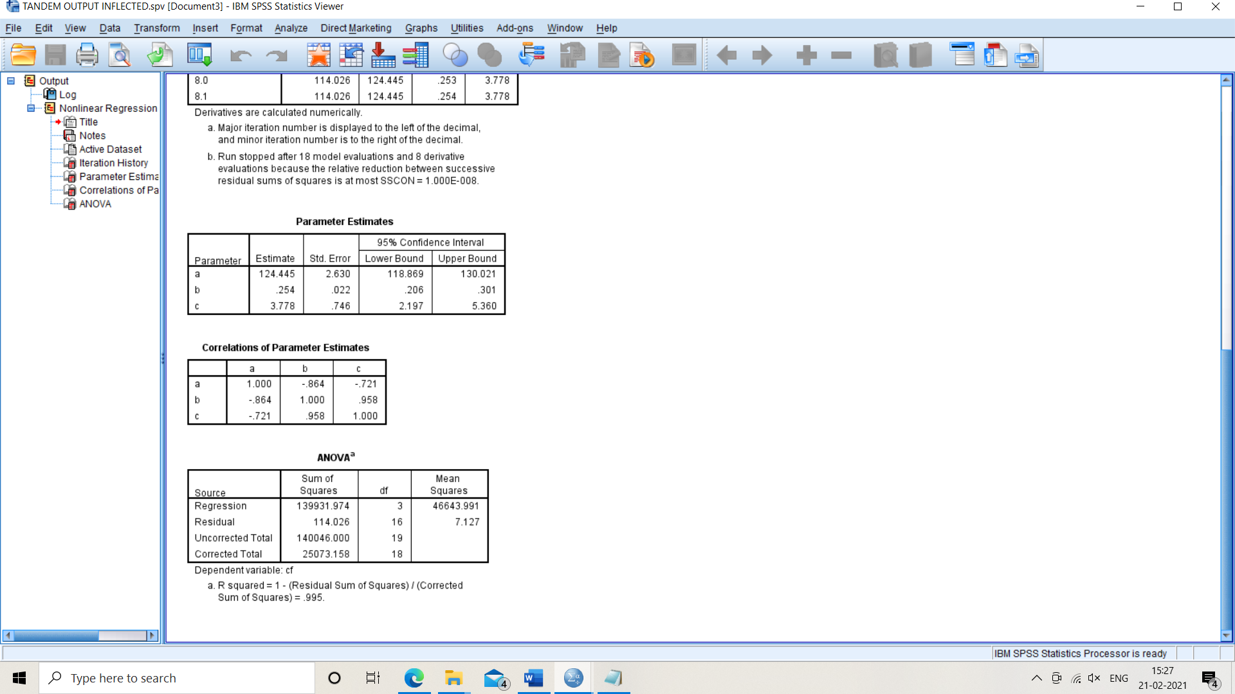


Slide 17
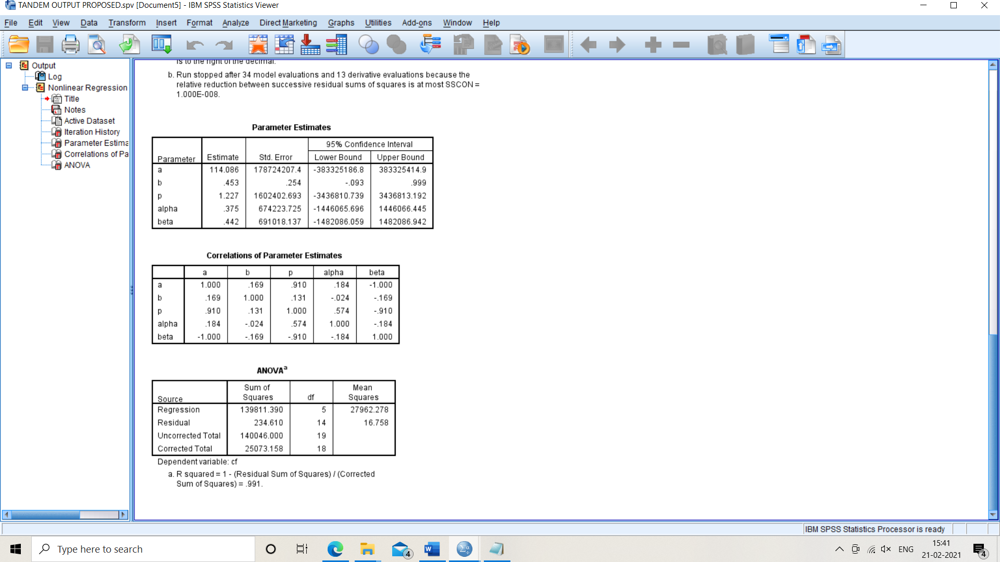
R squared of proposed model

Slide 18
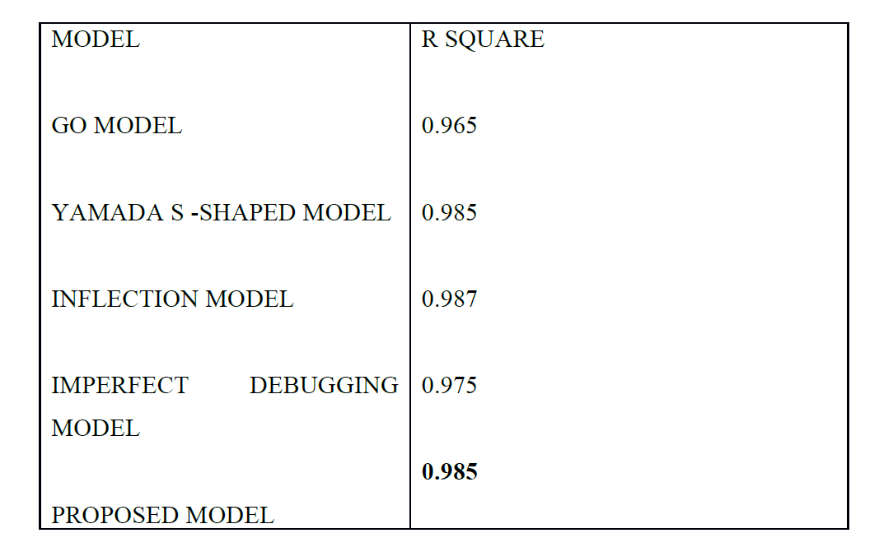
Monitor and control system data(DATASET 3)
RESULTS OF DATA SET 3

Slide 19



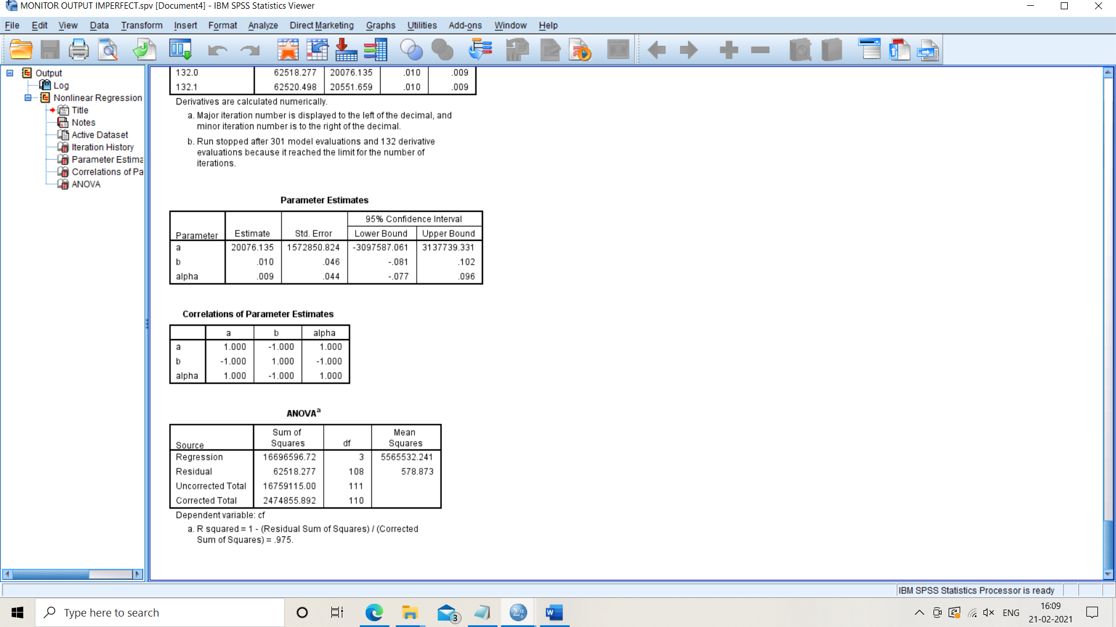

Slide 20
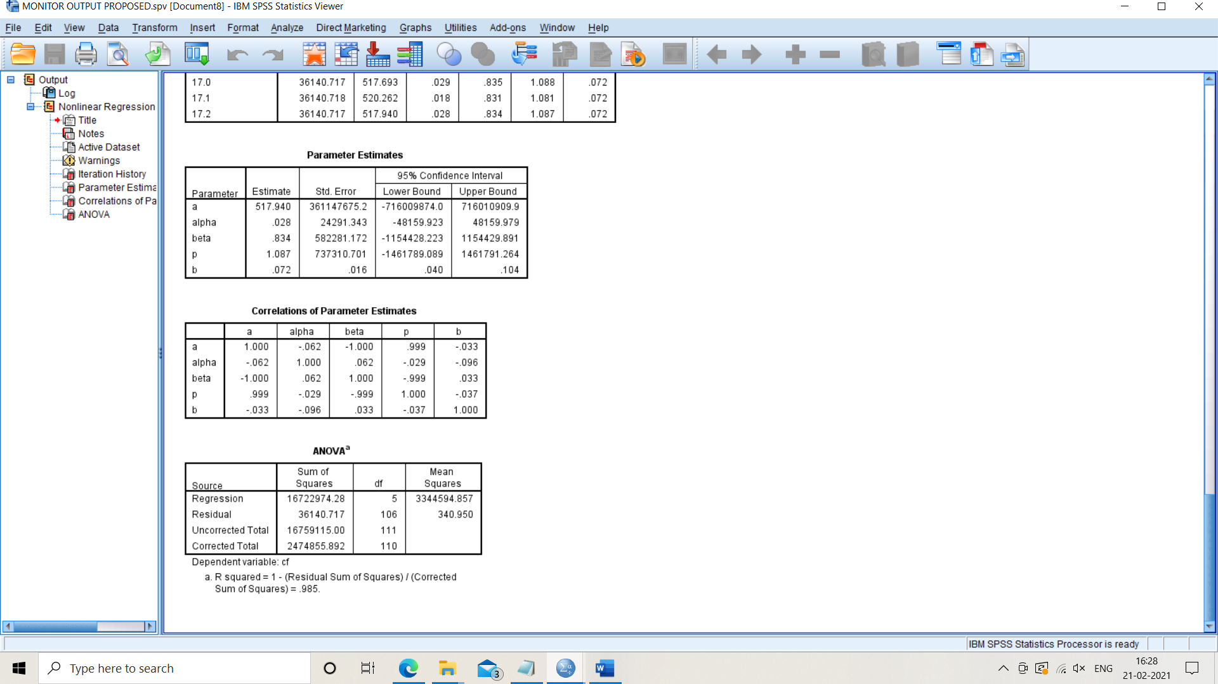
R squared of proposed model

Slide 21
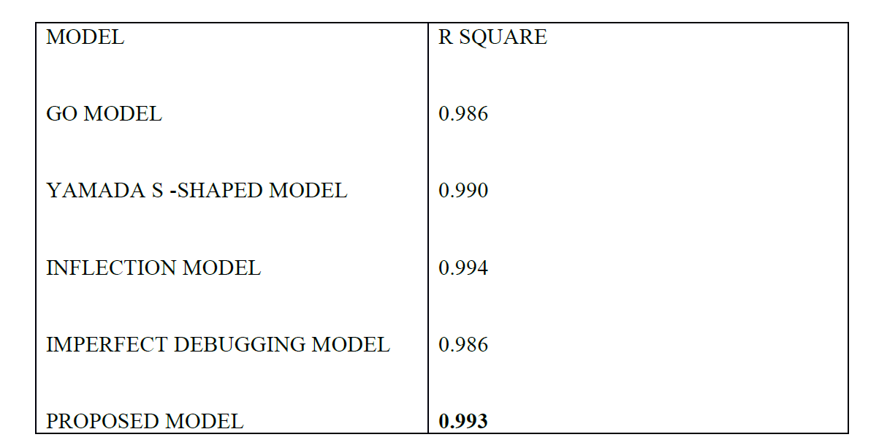
Failure data of wireless system (DATASET 4)
RESULTS OF DATA SET 4

Slide 22



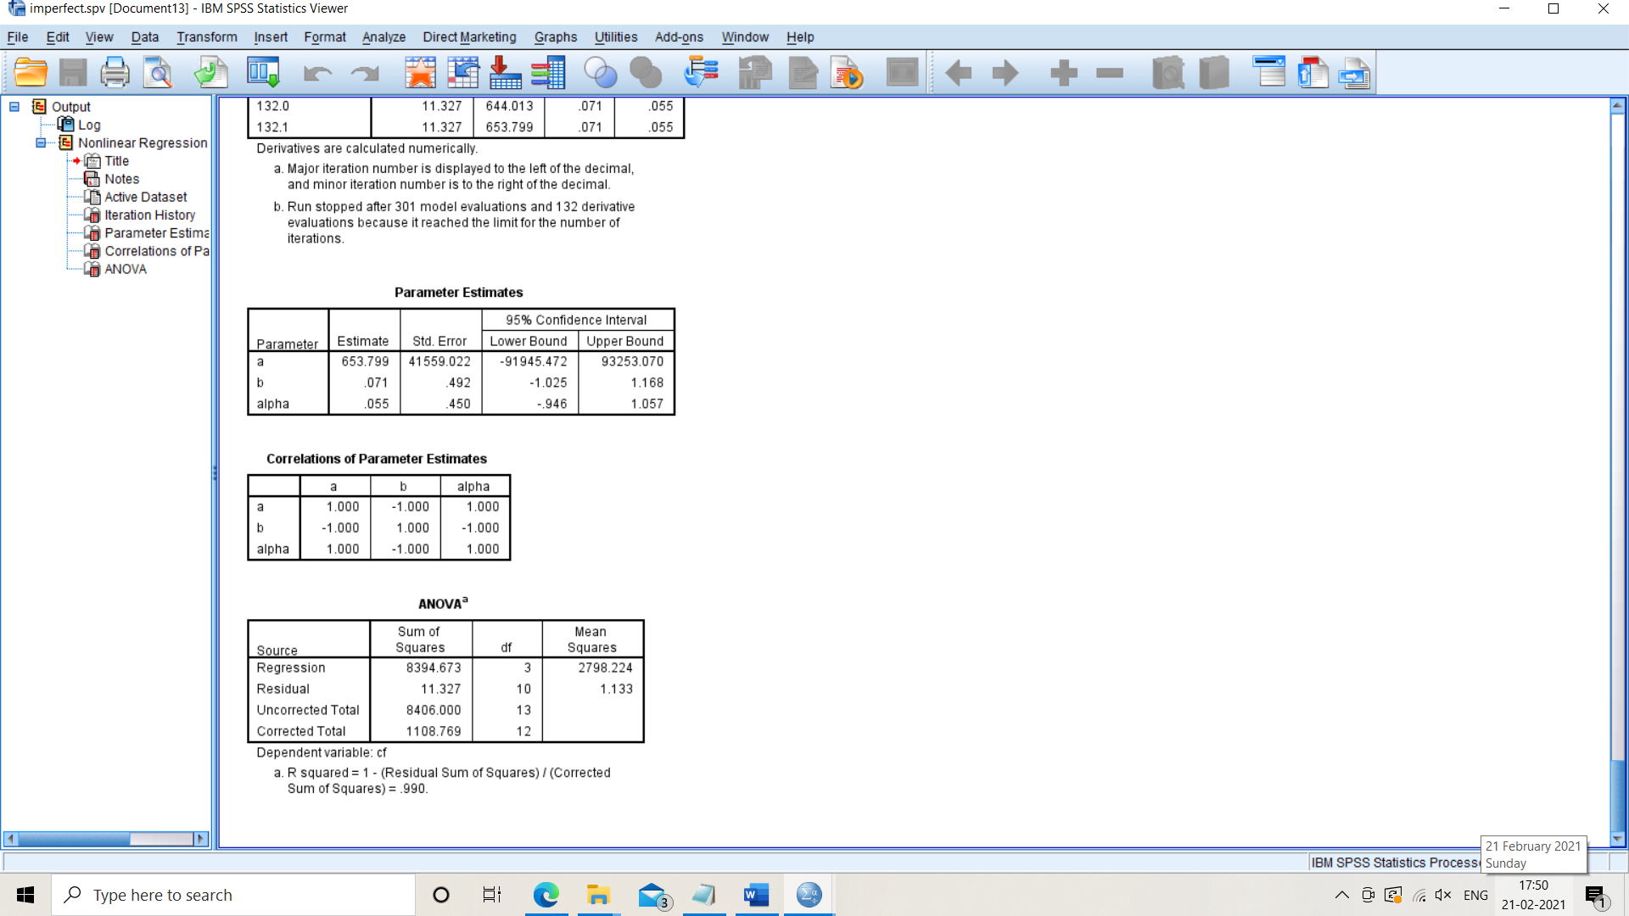

Slide 23
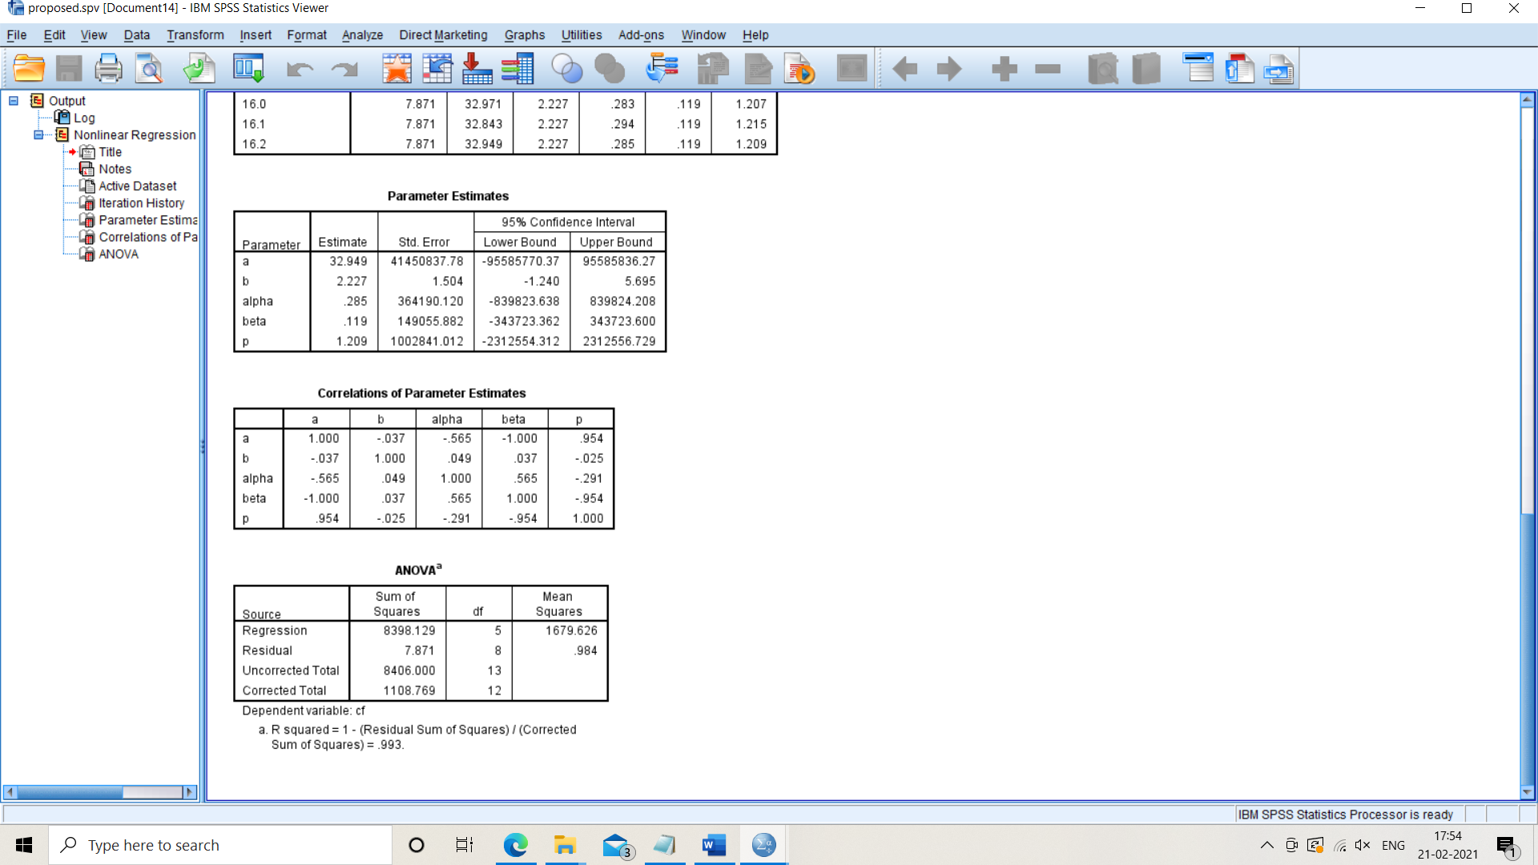
R squared of proposed model

Slide 24
RESULT SUMMARY
DATASET /MODEL | R² | Adjusted R² | MSE
1( GO model ) | 0.986 | 0.98425 | 156.264
1 ( S shaped model ) | 0.984 | 0.982 | 188.517
1 ( inflected model ) | 0.992 | 0.9904 | 98.211
1 ( imperfect model ) | 0.987 | 0.9844 | 162.896
1 ( proposed model ) | 0.989 | 0.9847 | 155.674
2 ( GO model ) | 0.982 | 0.9799 | 26.002
2 ( S shaped model ) | 0.990 | 0.9888 | 14.688
2 ( inflected model ) | 0.995 | 0.994 | 7.127
2 ( imperfect model ) | 0.984 | 0.981 | 25.365
2 ( proposed model ) | 0.991 | 0.9877 | 16.758
3 ( GO model ) | 0.965 | 0.9643 | 804.517
3 ( S shaped model ) | 0.985 | 0.9847 | 331.964
3 ( inflected model ) | 0.987 | 0.9866 | 300.140
3 ( imperfect model ) | 0.975 | 0.9742 | 578.873
3 ( proposed model ) | 0.985 | 0.9842 | 340.950
4 ( GO model ) 4 ( S shaped model ) | 0.986 0.986 | 0.9832 0.9832 | 1.375 1.375
4 ( inflected model ) | 0.994 | 0.992 | 0.715
4 ( imperfect model ) | 0.990 | 0.9866 | 1.133
4 ( proposed model ) | 0.993 | 0.9888 | 0.984

Slide 25
TESTING COVERAGE IN 2-D
To capture the combined effect of testing time and testing coverage a two-dimensional software reliability growth model by using Cobb-Douglas production function has been used.
The Cobb–Douglas production function is broadly used to represent the relationship of an output to inputs.
The amount of labor involved and the amount of capital invested give the production output in an economy.
The mathematical form of the production function is given as follows ;
Y= A L^{V} K^{1-V}
Where , Y is the total production per year.
L is the labour input.
ν is the elasticity of labour which is constant and determined by available technology.
K is the capital input and A is the factor productivity

Slide 26

ASSUMPTIONS OF COB DOUGLAS P.FXN
If either labour or capital vanishes, then so will production.
The marginal productivity of labour is proportional to the amount of production per unit of labour.
The marginal productivity of capital is proportional to the amount of production per unit of capital.
The basic characteristic of this function is linearly homogeneous with constant return to scale i.e. a proportion increase in all inputs leads to same proportion increase in output.
To cater the combined effect of testing time and resources , the cob douglas p. fxn is of the form
$$τ=s^{α}u^{1−α} 0≤α≤1$$
Where;
τ: testing resources u: testing coverage
s: testing time

Slide 27
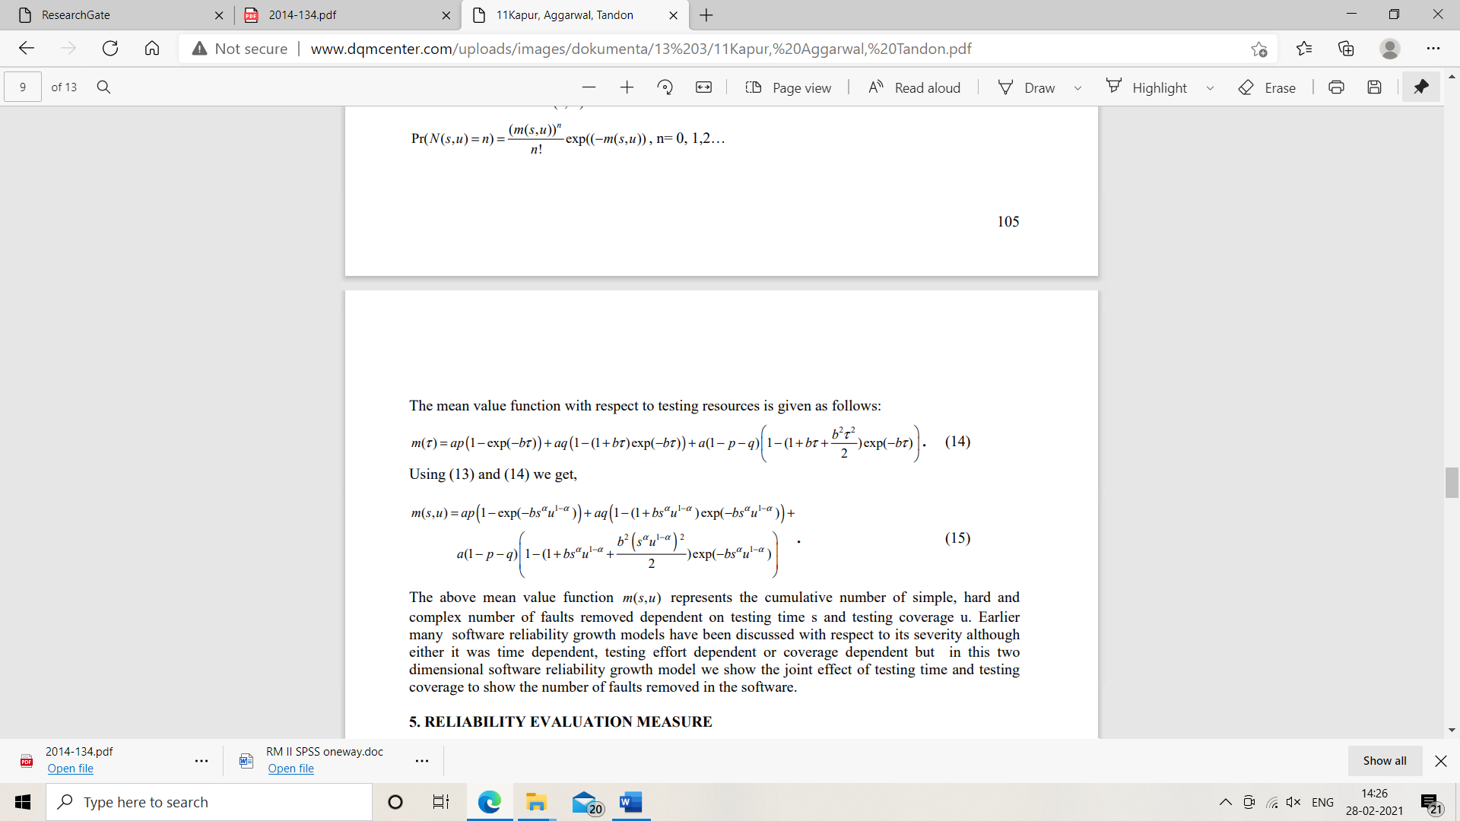
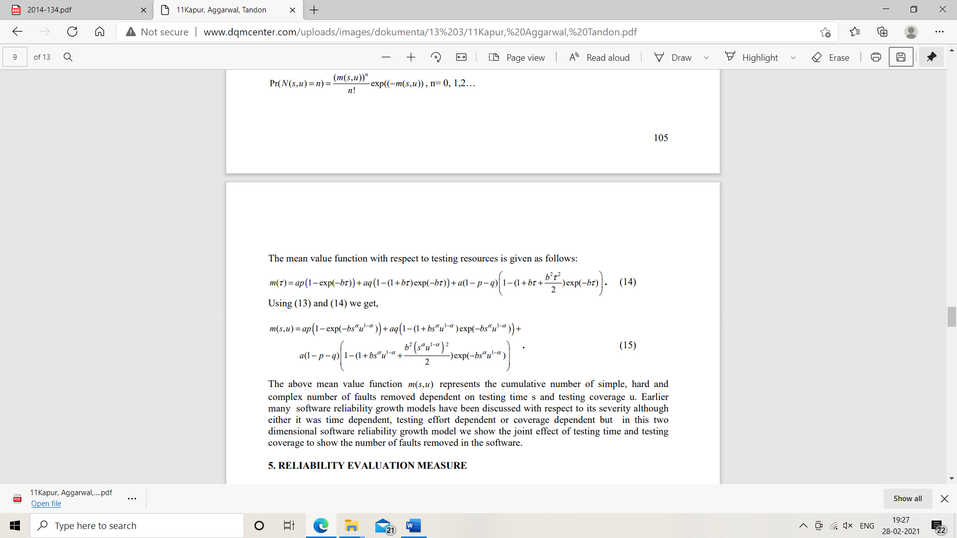
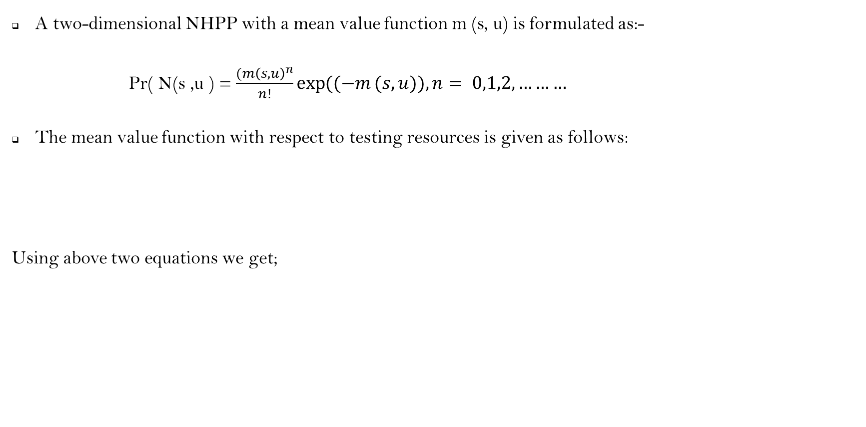
MEAN VALUE FUNCTION IN 2- D
A two-dimensional NHPP with a mean value function m (s, u) is formulated as:-
Pr( N(s ,u ) = $\frac{(m{\left(s,u\right)}^{n}}{n!}\exp{((−m}(s,u)), n= 0,1,2,………$
The mean value function with respect to testing resources is given as follows:
Using above two equations we get;

Slide 28
CONTD.
m(t): Expected number of faults removed in the time interval 0,t .
c(t): testing coverage as a function of time t
a: Constant, representing the number of faults lying dormant in the software at the beginning of testing
a₁: Constant, representing the number of Simple faults lying dormant in the software at the beginning of testing
a₂: Constant, representing the number of Hard faults lying dormant in the software at the beginning of testing
a₃: Constant, representing the number of Complex faults lying dormant in the software at the beginning of testing
b: Cons tant fault detection / isolation / correction rate

Slide 29
CONTD.
b₁: Cons tant fault detection / isolation / correction rate for simple faults
b₂: Cons tant fault detection / isolation / correction rate for hard faults
b₃: Cons tant fault detection / isolation / correction rate for complex faults
p: Proportion of simple faults lying in the software
q: Proportion of hard faults lying in the software
DATASET
The dataset has been taken from a NASA project.
The coverage dataset has 796 test cases and 9 cumulative number of failures

Slide 30
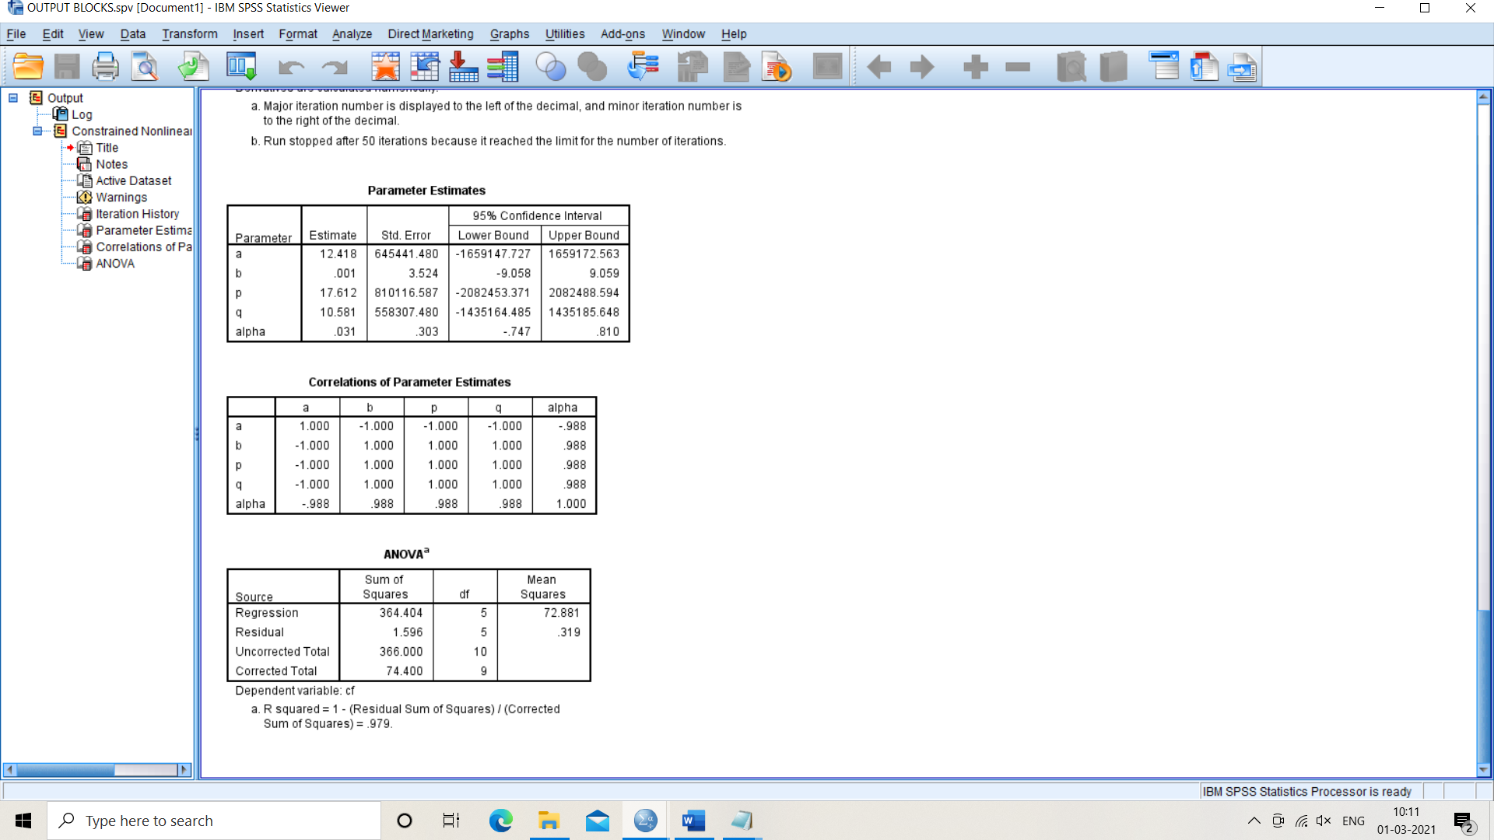


RESULTS
BLOCKS C-USES P-USES

Slide 31
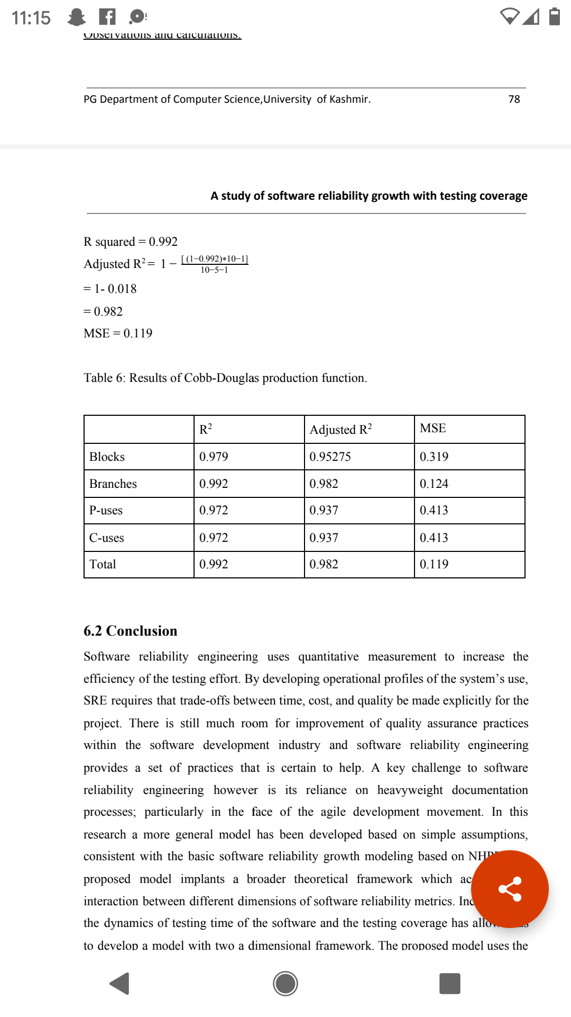
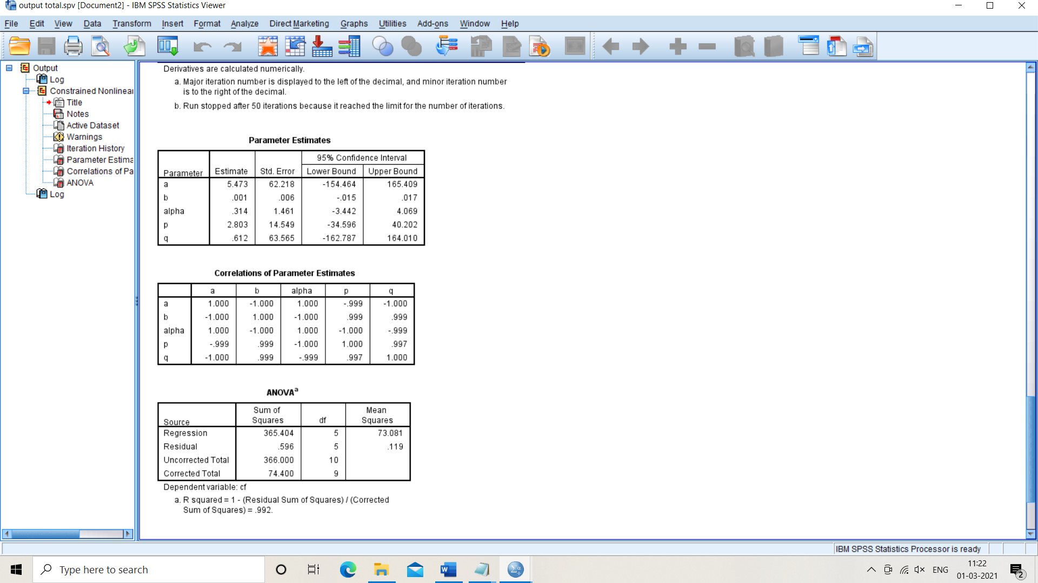
RESULTS
Total coverage
total coverage = blocks + branches+ p uses +c uses
RESULT SUMMARY

Slide 32
CONCLUSIONS AND FUTURE WORK
The proposed model implants a broader theoretical framework which accounts for interaction between different dimensions of software reliability metrics.
The proposed model produces reliable and good results.
An optimal release policy can be framed in future.

Slide 33
ACKNOWLEDGEMENT
I would like to thank my department and my guide Dr. Javaid Iqbal for his valuable guidance.

